Slide 1

Mamba and
Mamba Unet
By
Weitao Xiong
Advisor:
Prof. Hongfei Xue

Slide 2

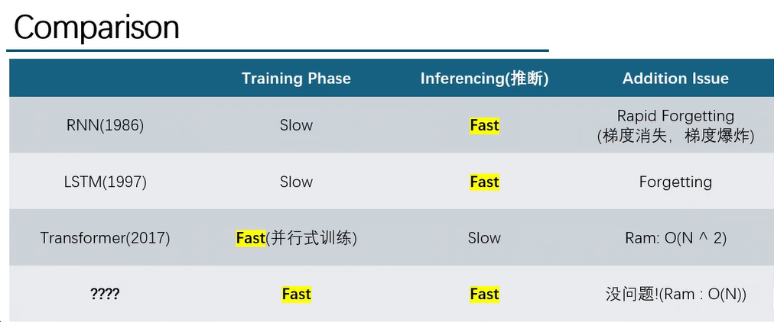
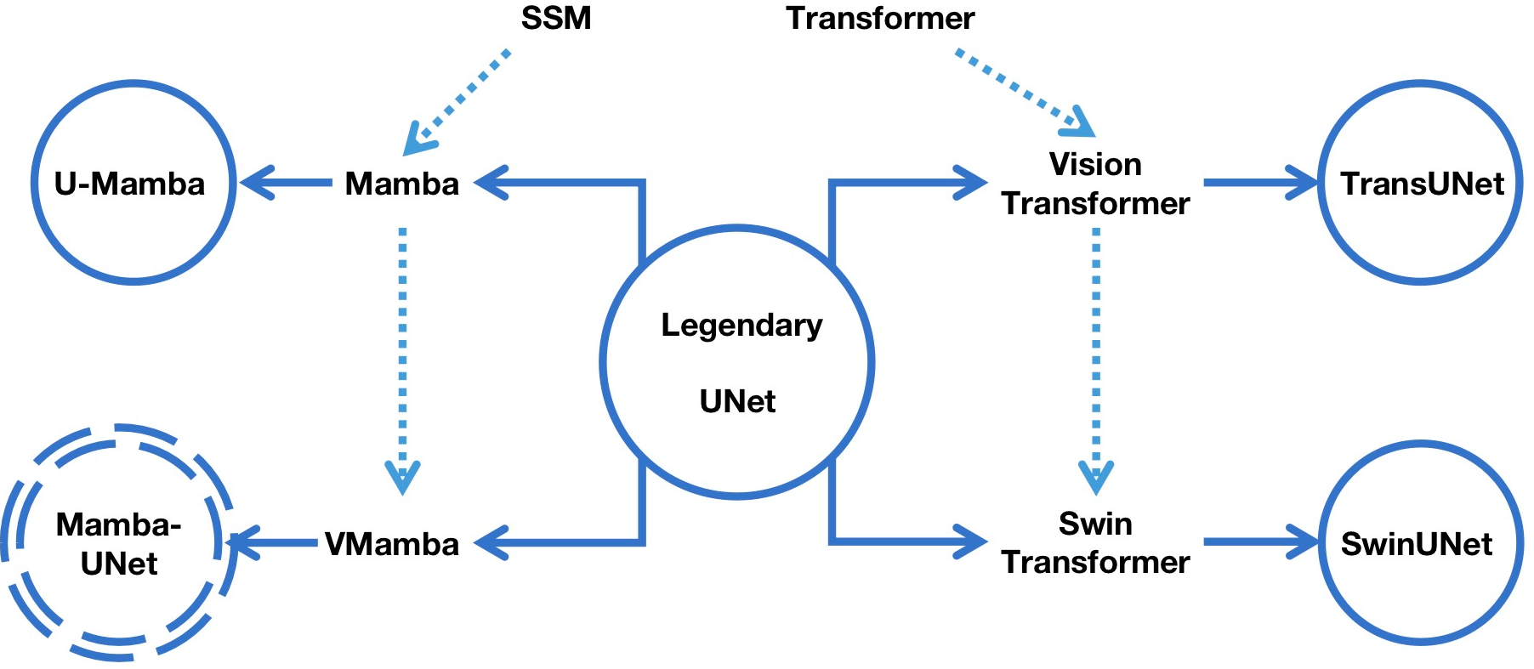
Why we need a new model?
U-Mamba (2024.1.9):
Image Segmentation
Vision Mamba (2024.1.17):
Classification
Mamba Unet(2024.2.7):
Semantic Segamentation
Mamba
(2023.12.1)

Slide 3
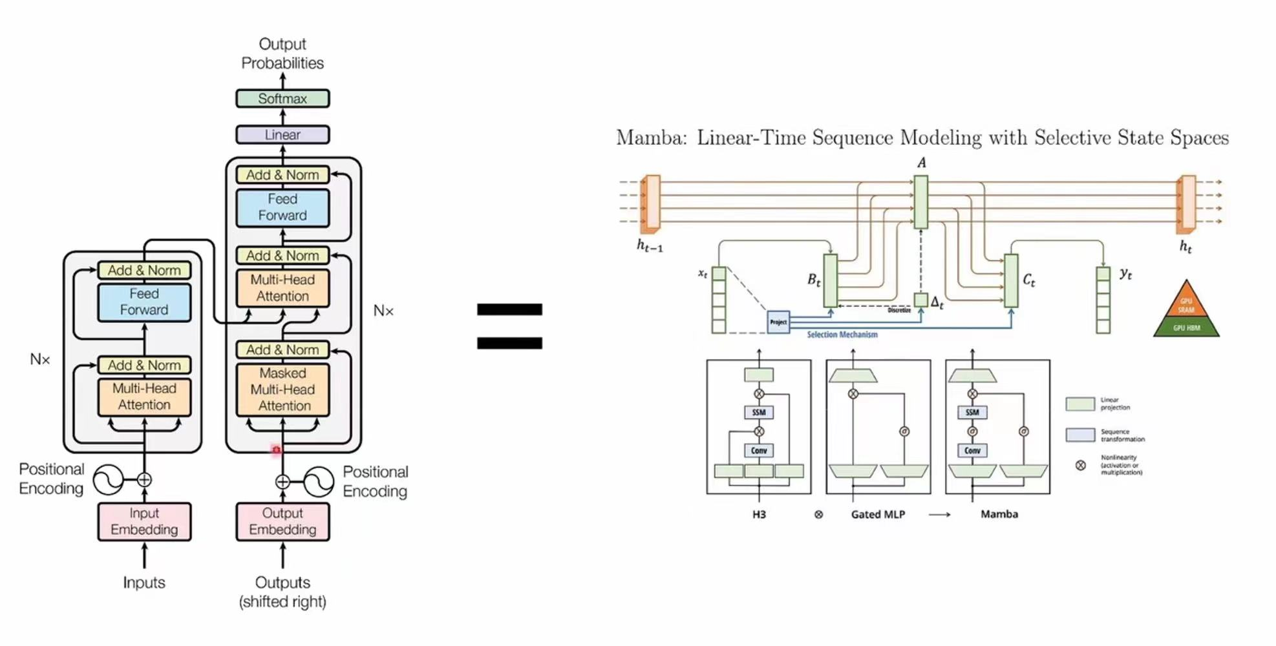
If you use Transformer Block in your model, you can just replace it with Mamba Block.

Slide 4
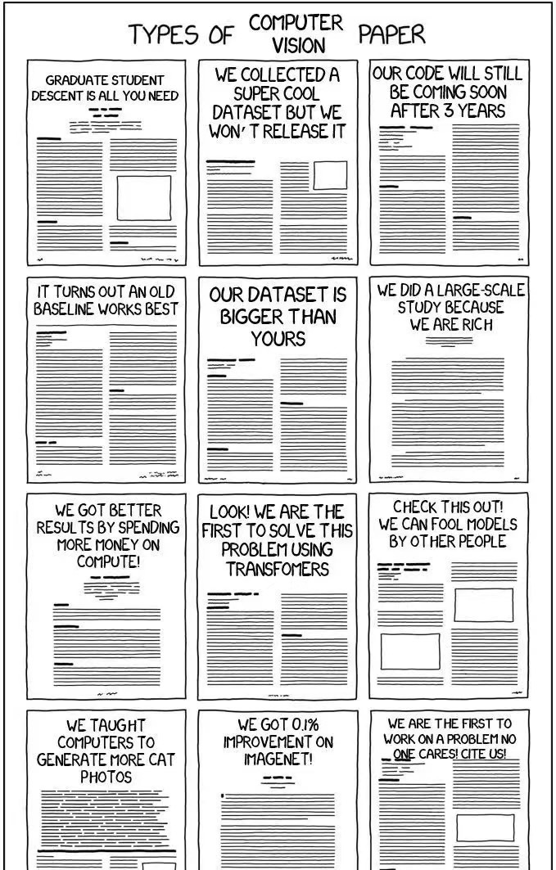

Some Jokes
However, Mamba is rejected by ICLR 2024.
Rate is 8/8/6/3.

Slide 5
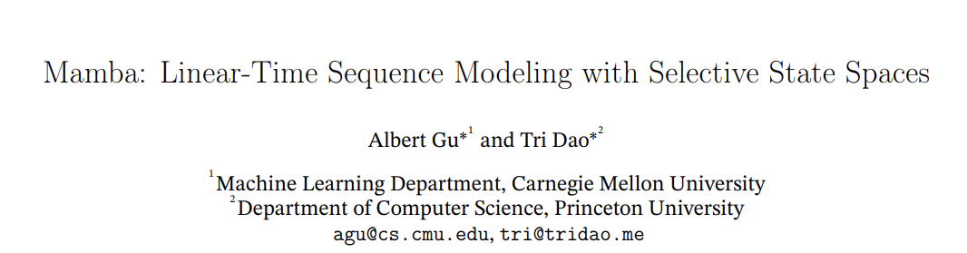

What is Mamba?
Three keywords:
Linear-Time Sequence Model
State Space Model (SSM)
Selective
Previous work
New work

Slide 6
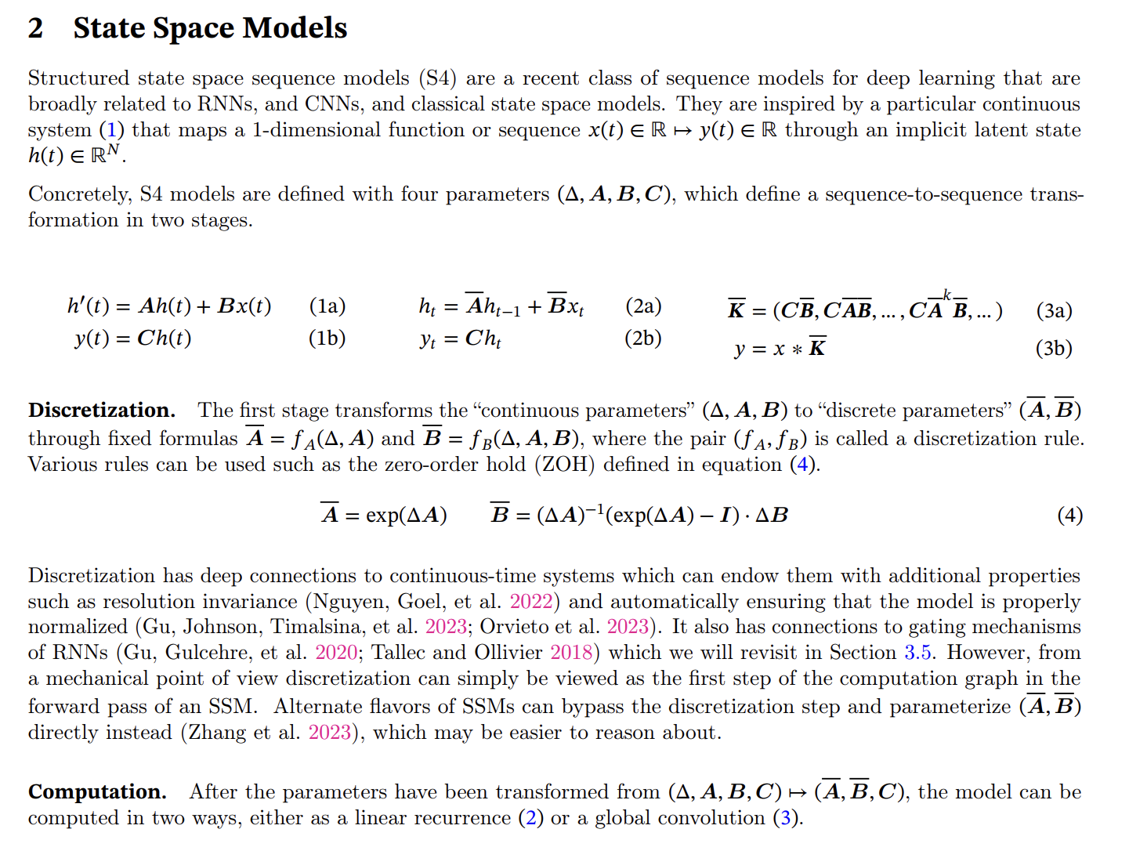
These are all core equations, and we will first focus on his previous work --- State Space Model, HiPPO, and S4 Model.

Slide 7
State Space Model

Slide 8
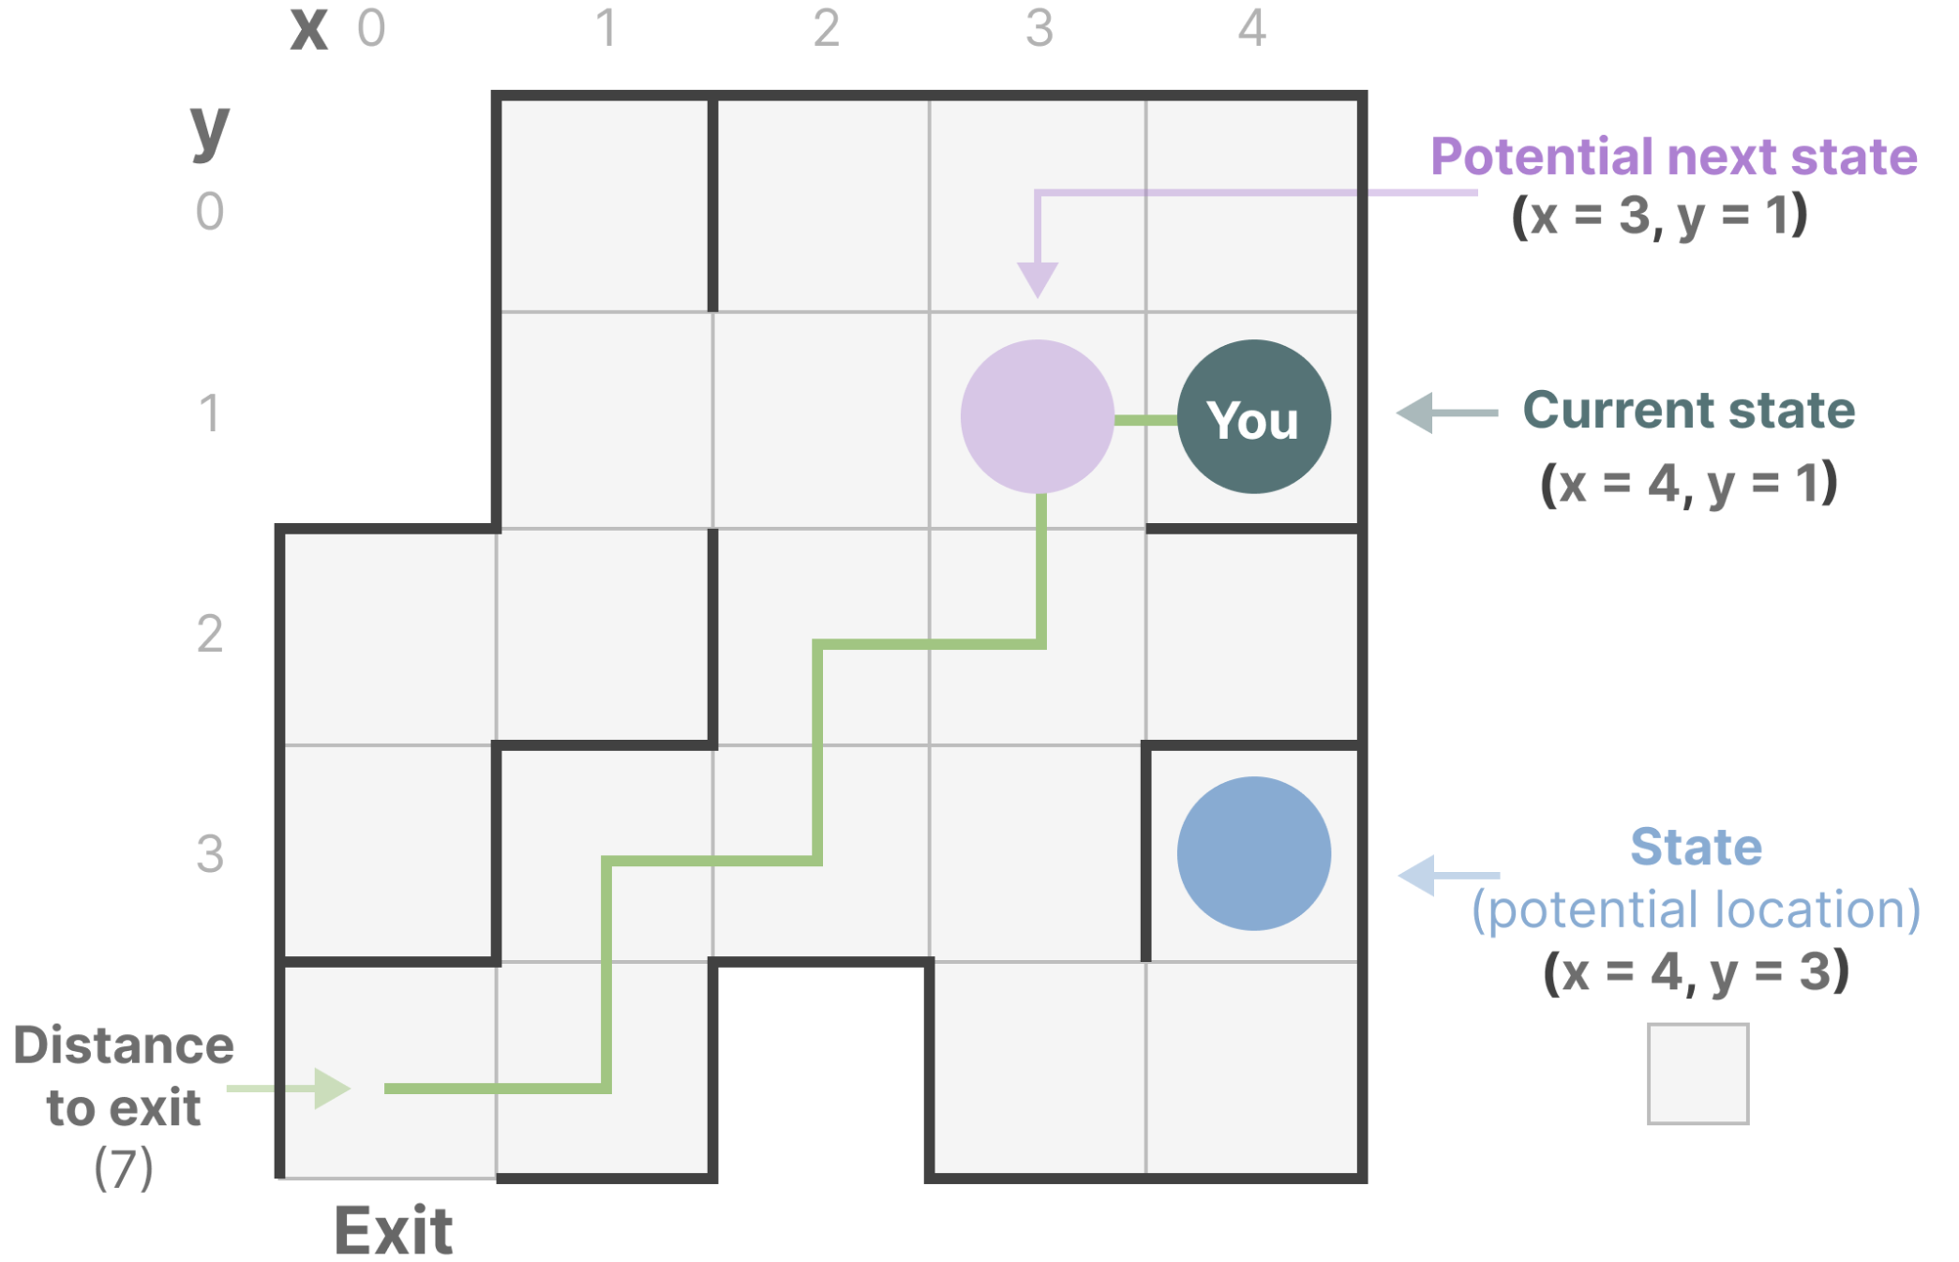
What is State Space?
State Space is a discrete space representing the set of all possible configurations of a "system".
Example:
“State Space” is the map of all possible locations (states). Each point represents a unique position in the maze with specific details, like how far you are from the exit.
“State Space Representation” is a simplified description of this map. It shows:
where you are (current state),
where you can go next (possible future states)
what changes take you to the next state (going right or left).

Slide 9
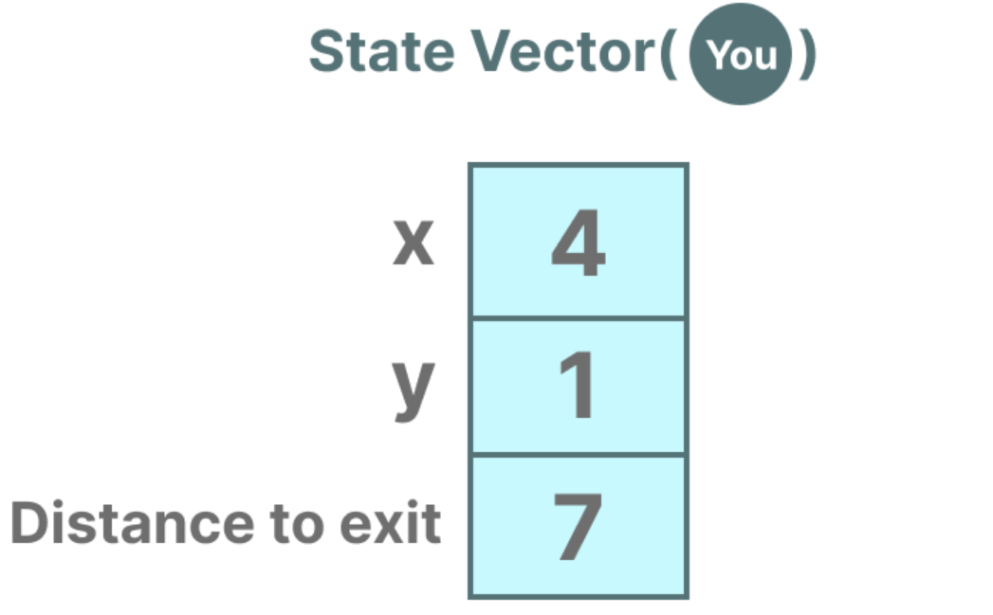
It is similar to embeddings or vectors in language models, both of them frequently used to describe the “state” of an input sequence.
In terms of neural networks, the “state” of a system is typically its hidden state and in the context of Large Language Models, one of the most important aspects of generating a new token.

Slide 10
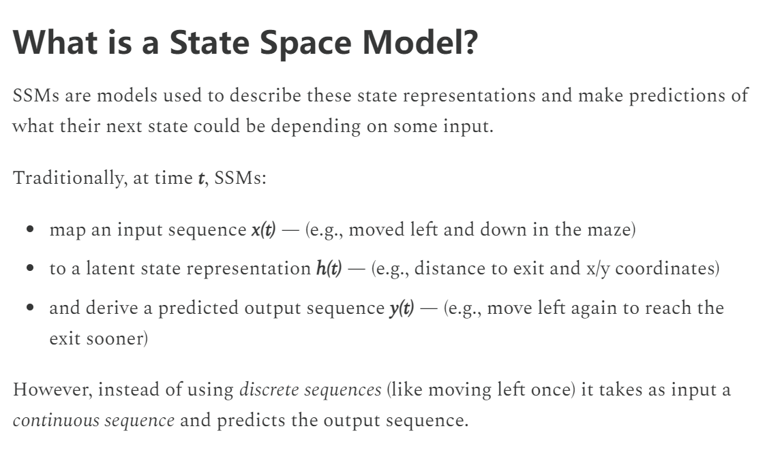
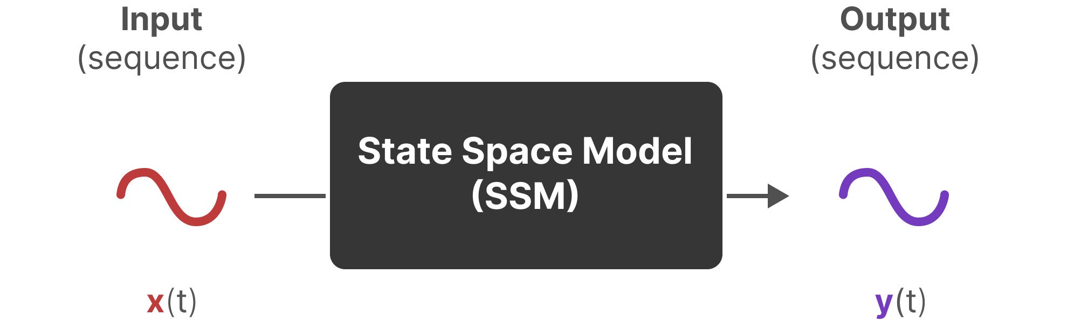
State Space Model

Slide 11
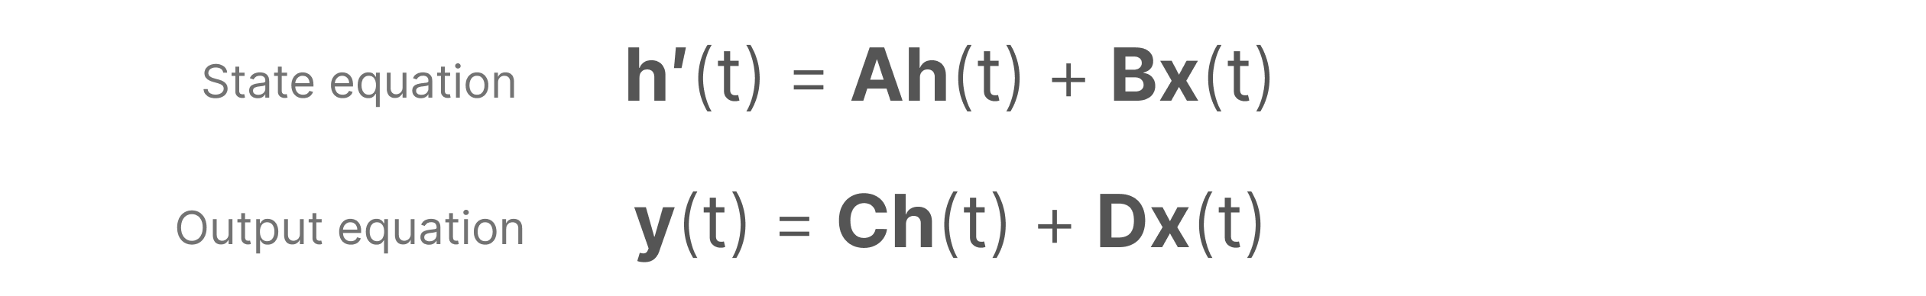
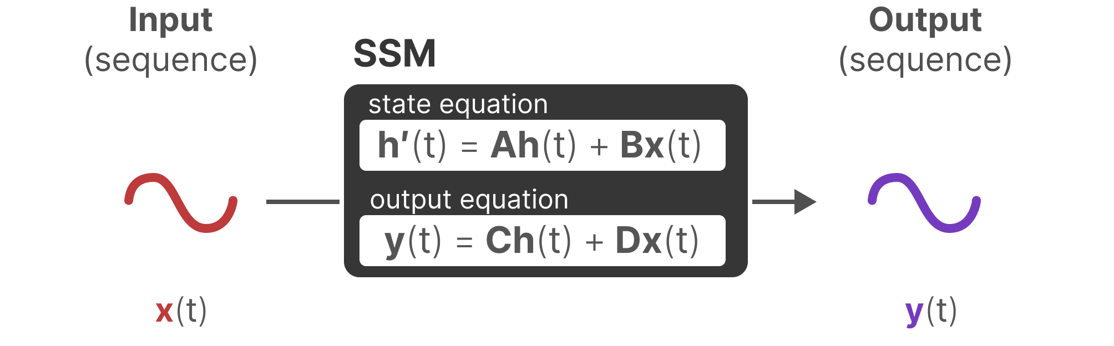
Standard equation in SSM

Slide 12
Derivation the standard equation in SSM

Slide 13
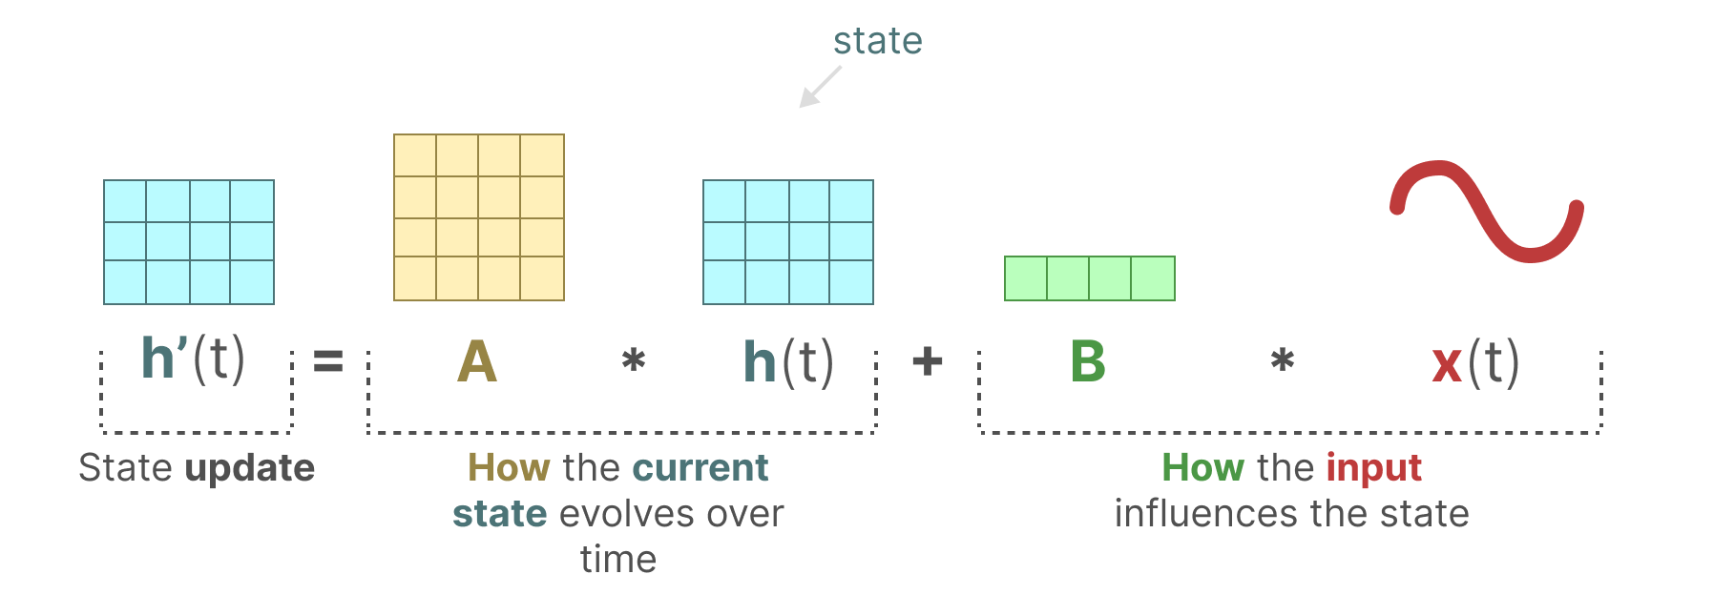
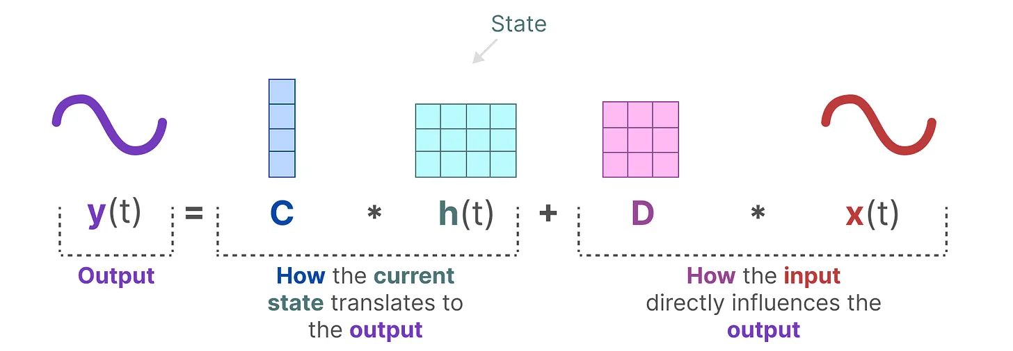

Do you think it is similar to the way you do in the Kalman filter?

Slide 14
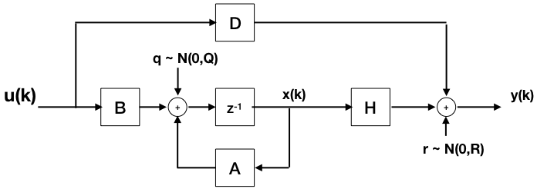
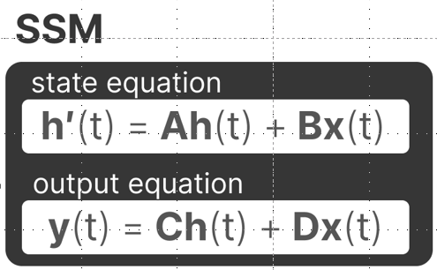
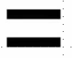
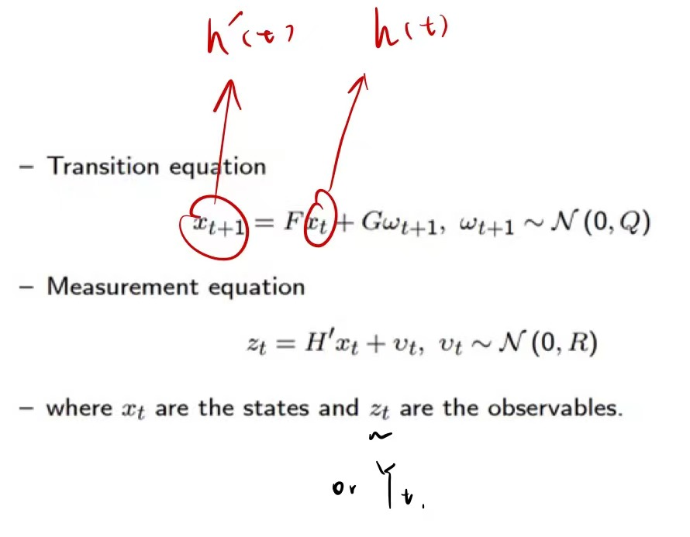
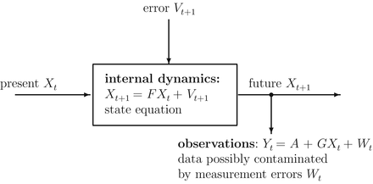
Kalman Filter using SSM

Slide 15
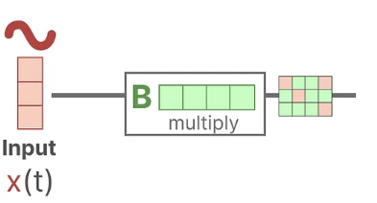
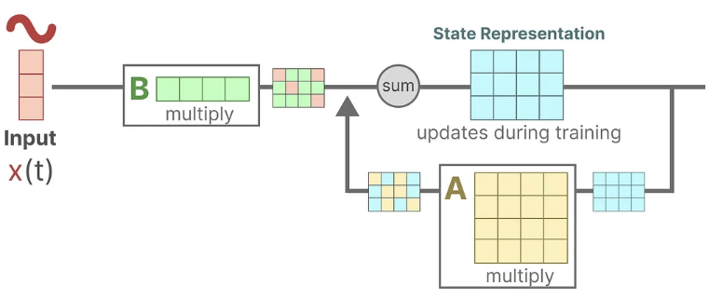
More detail about SSM
Assume we have some input signal x(t), this signal first gets multiplied by matrix B which describes how the inputs influence the system.
The updated state (akin to the hidden state of a neural network) is a latent space that contains the core “knowledge” of the environment. We multiply the state with matrix A which describes how all the internal states are connected as they represent the underlying dynamics of the system.

Slide 16
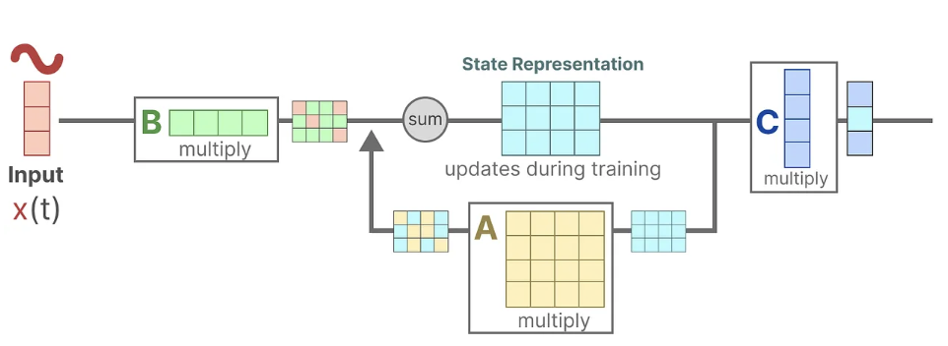
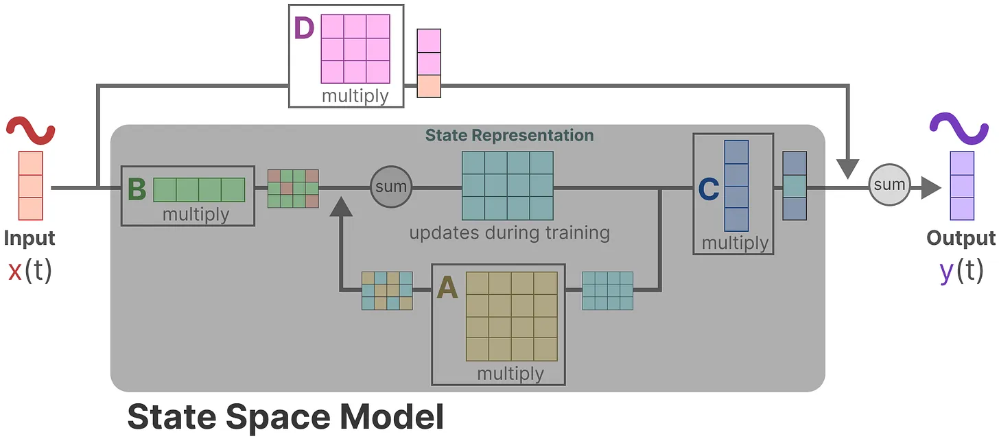
Then, we use matrix C to describe how the state can be translated to an output.
Finally, we can make use of matrix D to provide a direct signal from the input to the output. This is also often referred to as a skip-connection. The SSM is often regarded as the following without the skip-connection.

Slide 17

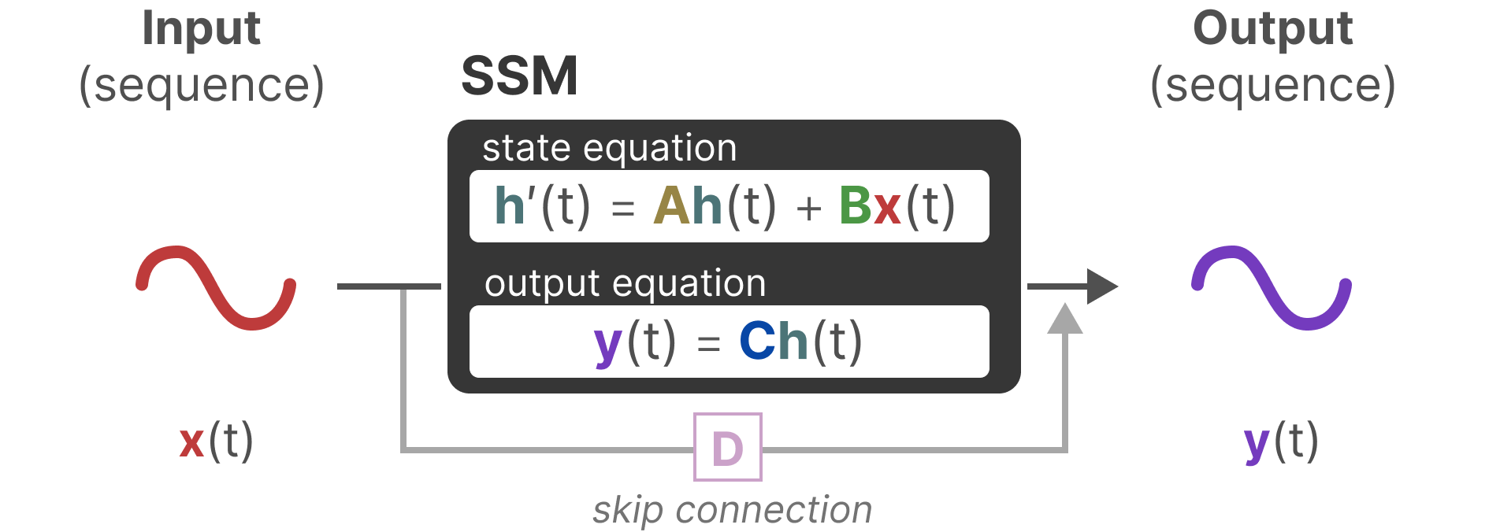
We can now focus on matrices A, B, and C as the core of the SSM.

Slide 18
Discretization
As a continuous-time system, SSM is difficult to directly integrate into Deep Learning model:
Calculation Efficiency: Modern deep learning frameworks and hardware are usually designed based on discrete-time operations. Only after discretizing SSM can it be transformed into a model that can run efficiently on these frameworks and hardware.
Training Algorithms: Most deep learning training algorithms, such as gradient descent and backpropagation, are designed for discrete-time models. Discretization allows these algorithms to be directly applied to state-space models.
Practical Applications: In many practical applications, data is discrete, such as text data (word sequences), time series data (stock prices, sensor readings), etc. Discrete-time models match these data formats more naturally.
Model Complexity: The discretization process can control the complexity of the model by selecting an appropriate time step size T.

Slide 19
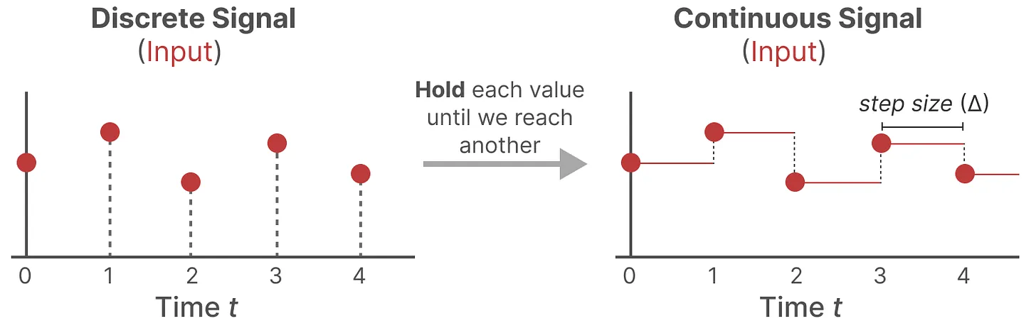
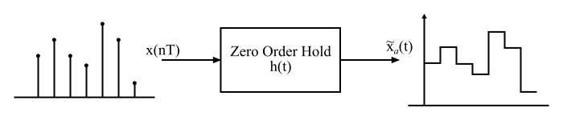
Zero-order hold
In the zero-order hold reconstruction method, the continuous signal is reconstructed from its samples by holding the given sample for an interval until the next sample is received.

Slide 20
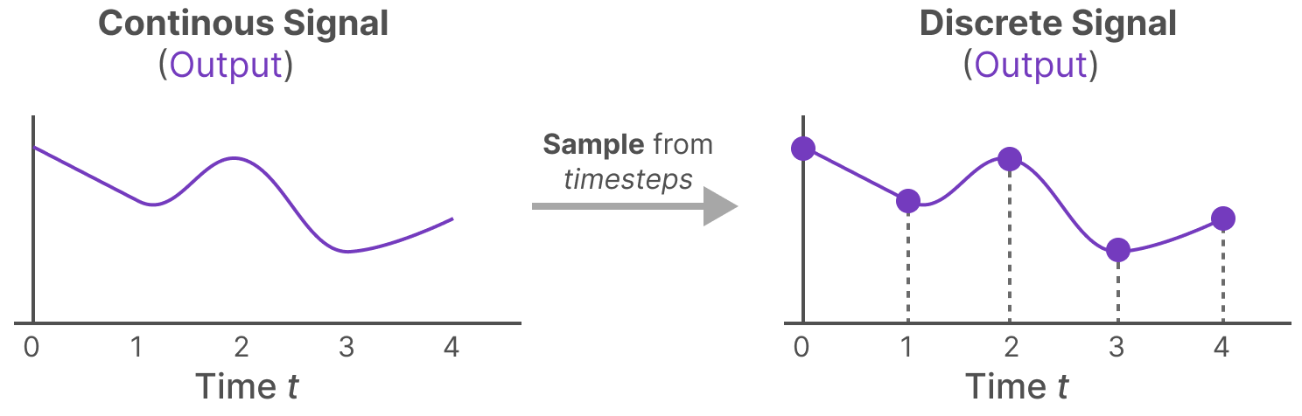
How long we hold the value is represented by a new learnable parameter, called the step size ∆. It represents the resolution of the input.
If we have a continuous signal for our input, we can generate a continuous output and only sample the values according to the time steps of the input.

Slide 21
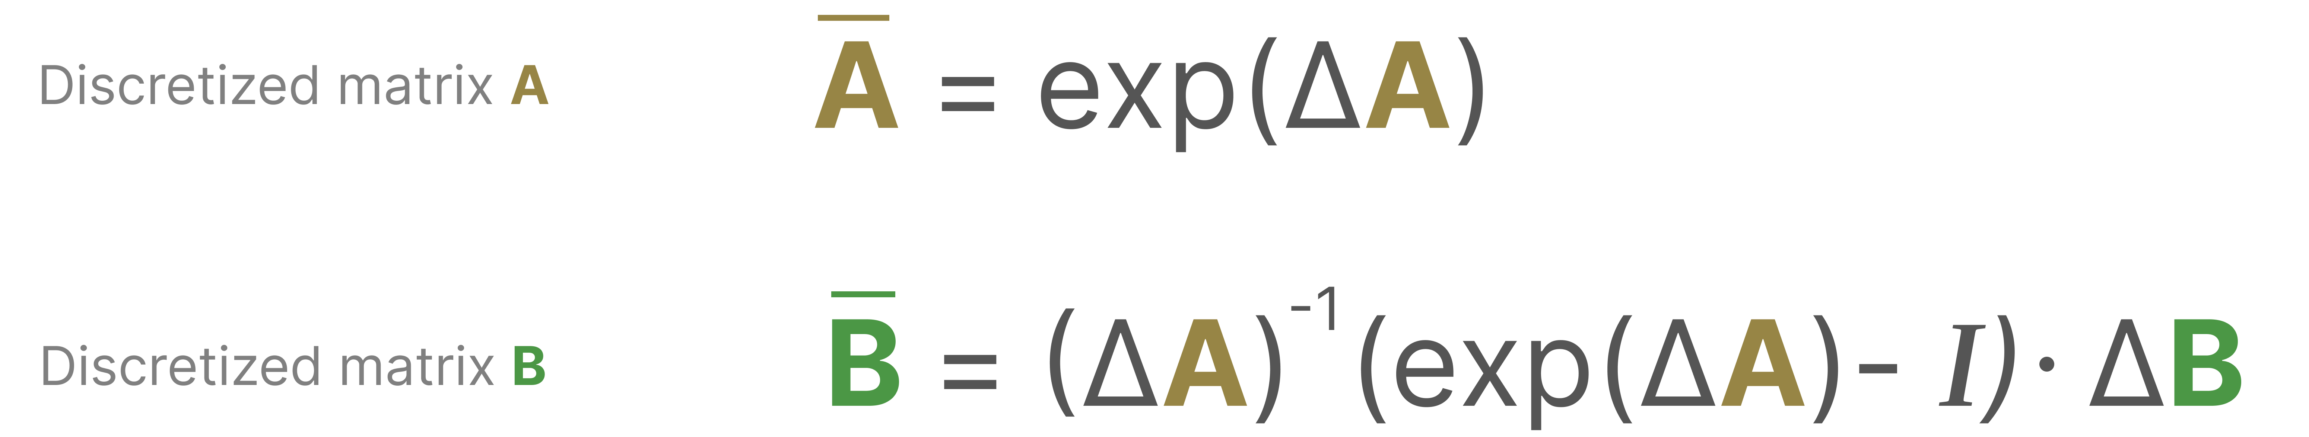
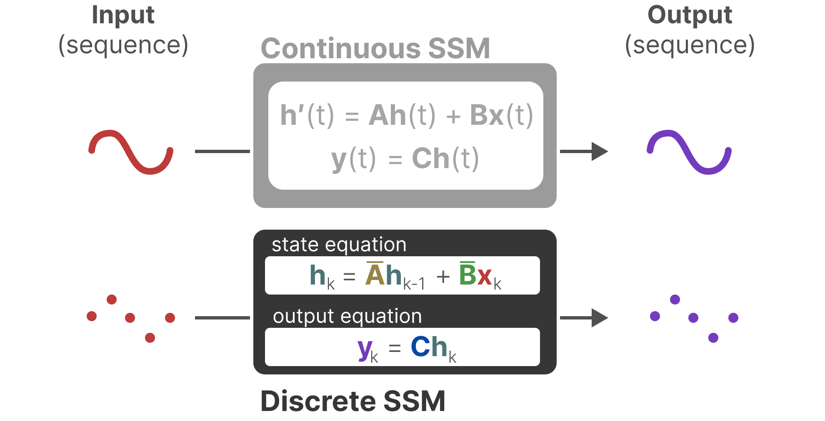
Mathematically, we can apply the Zero-order hold as follows:

Slide 22
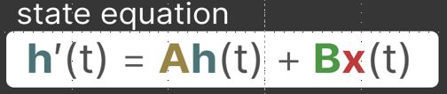
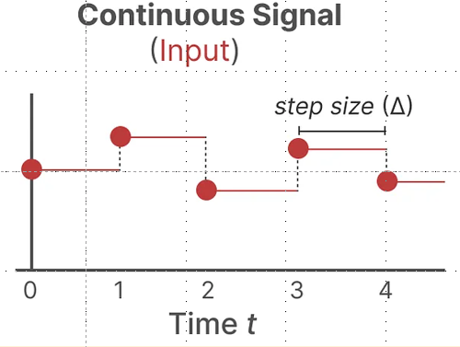
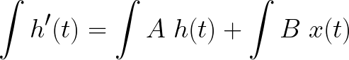
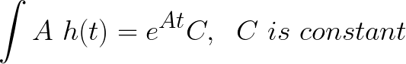
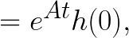
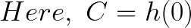
Formula Derivation
Non-homogeneous function
homogeneous function
Matrix Exponential
(More detail in 3D Rotation)

Slide 23
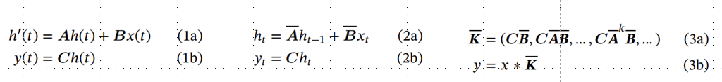
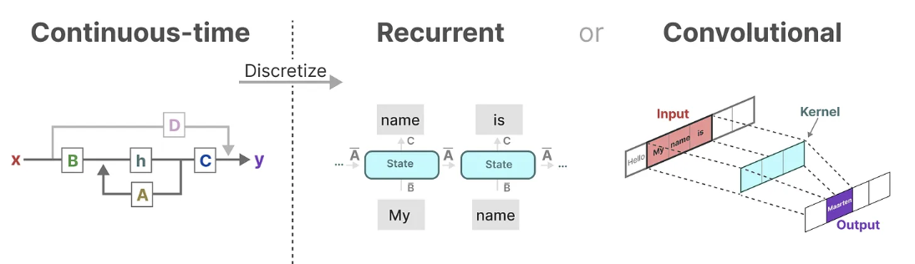
Three Representation

Slide 24
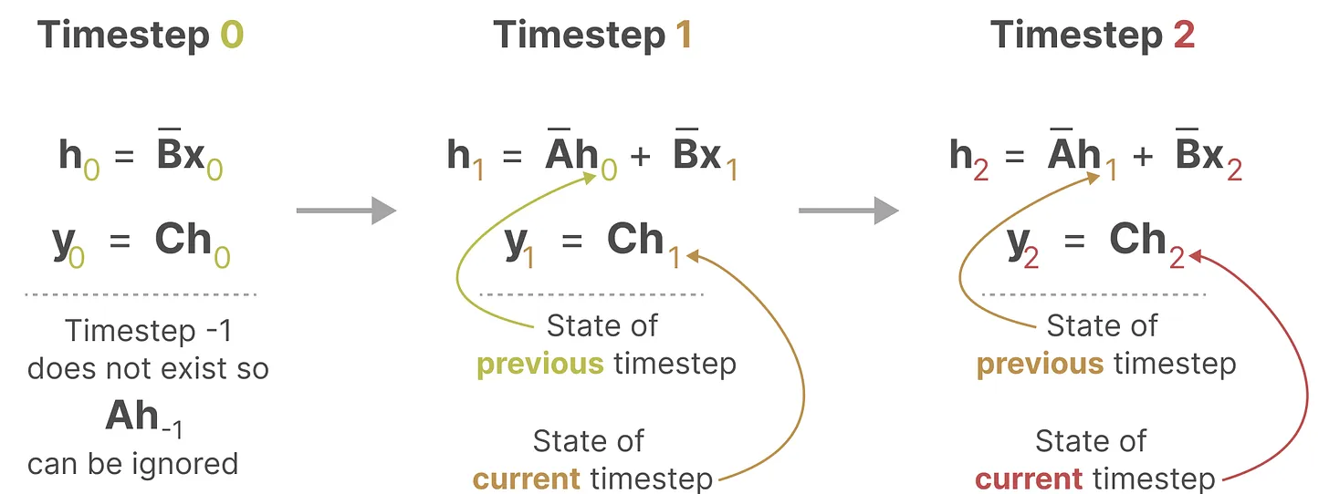
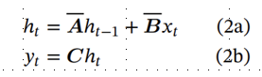
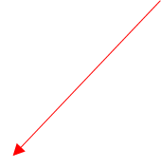
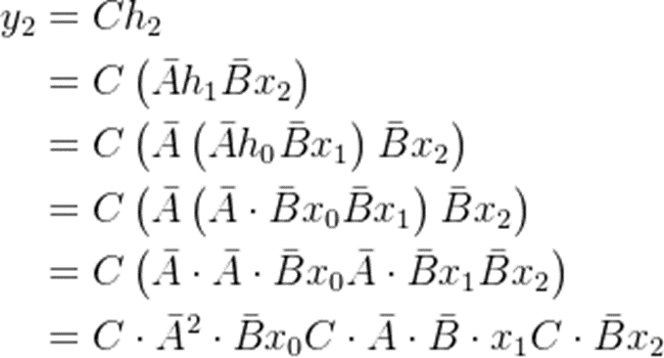
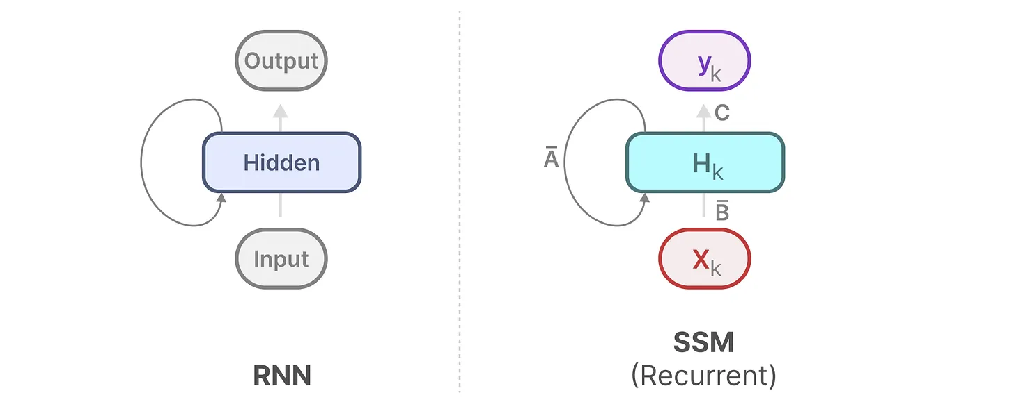
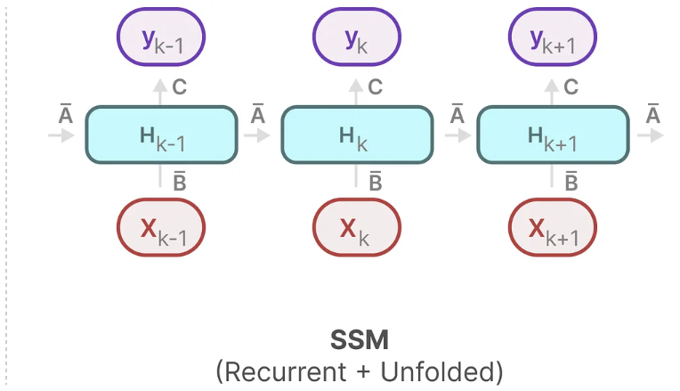
The Recurrent Representation

Slide 25
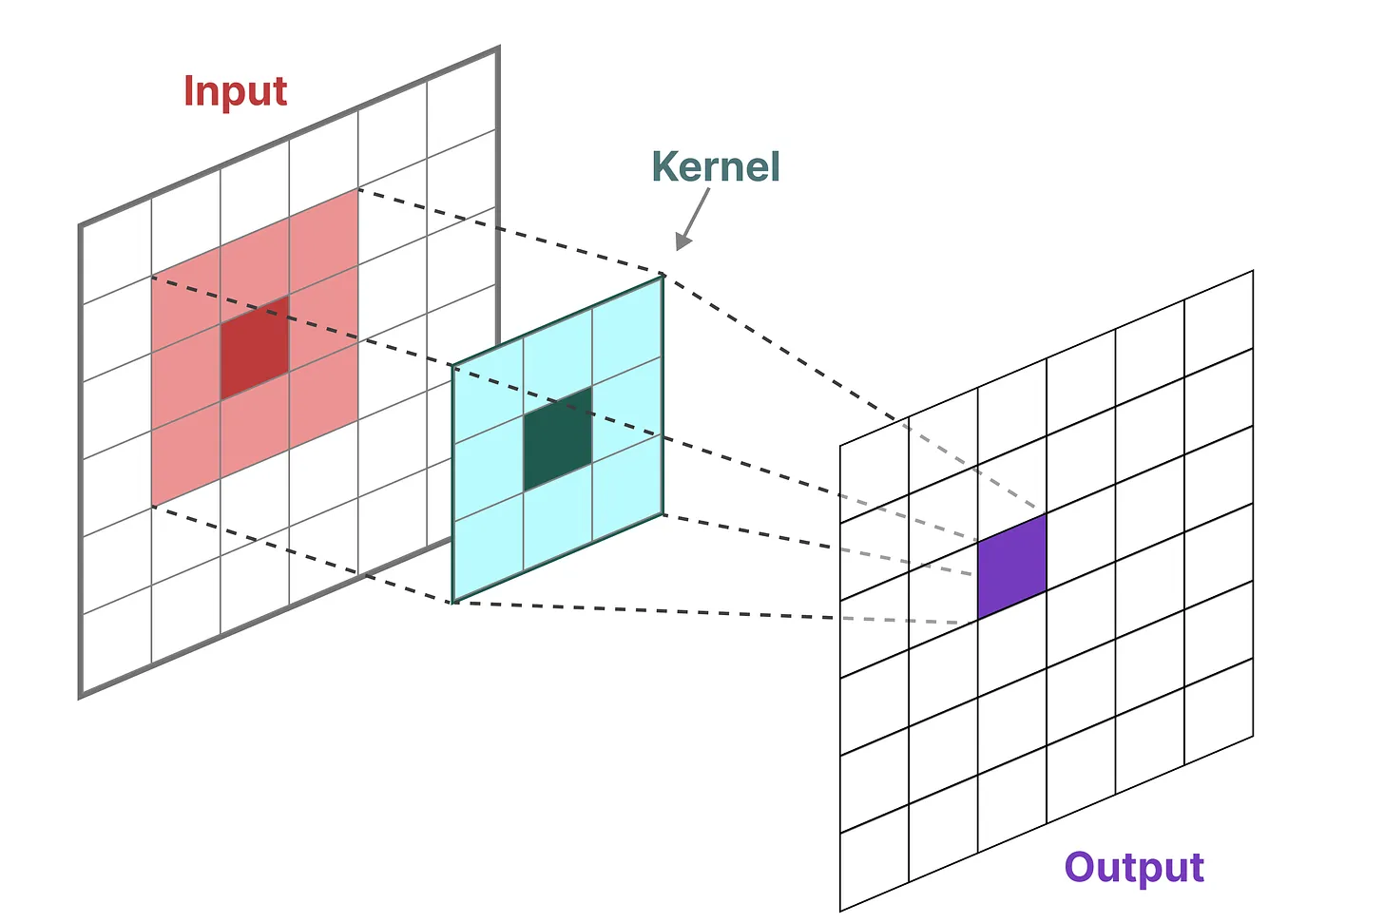
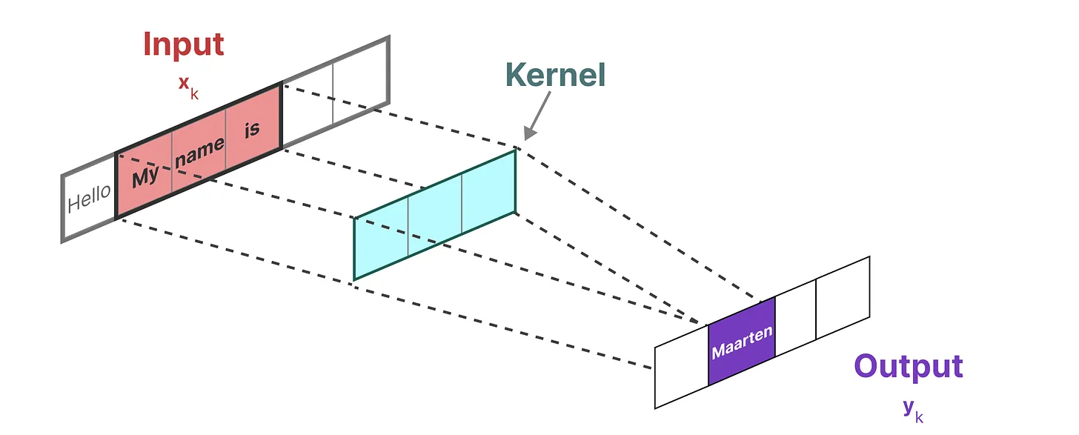
The Convolution Representation
Another representation that we can use for SSMs is that of convolutions. In classic image recognition tasks, we applied filters (kernels) to derive aggregate features:
Since we are dealing with text and not images, we need a 1-dimensional perspective instead:

Slide 26
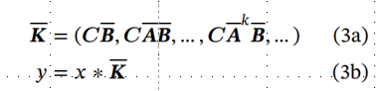
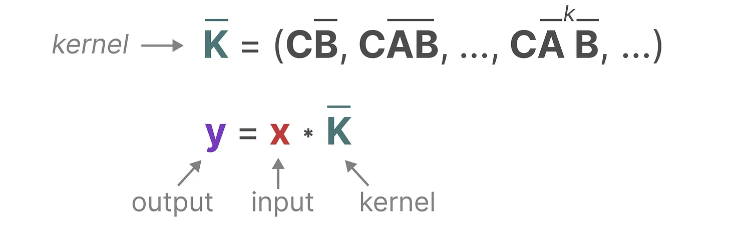
The kernel that we use to represent this “filter” is derived from the SSM formulation:

Slide 27
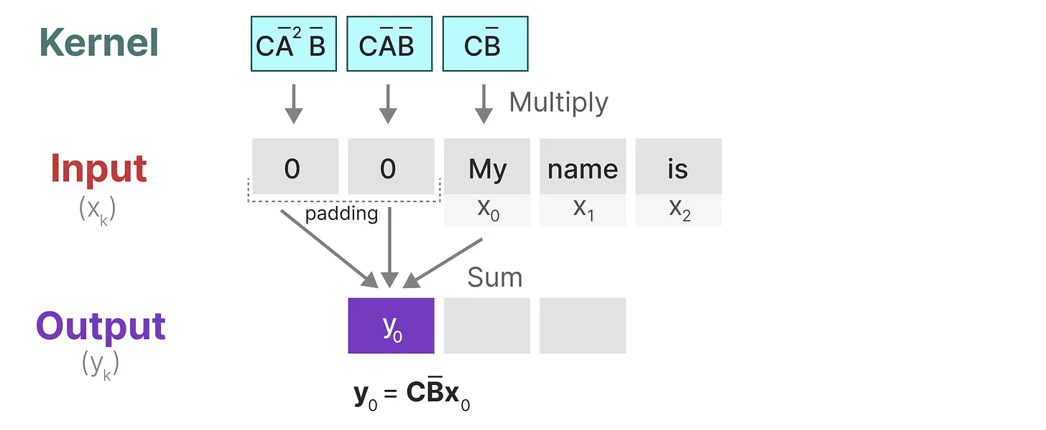

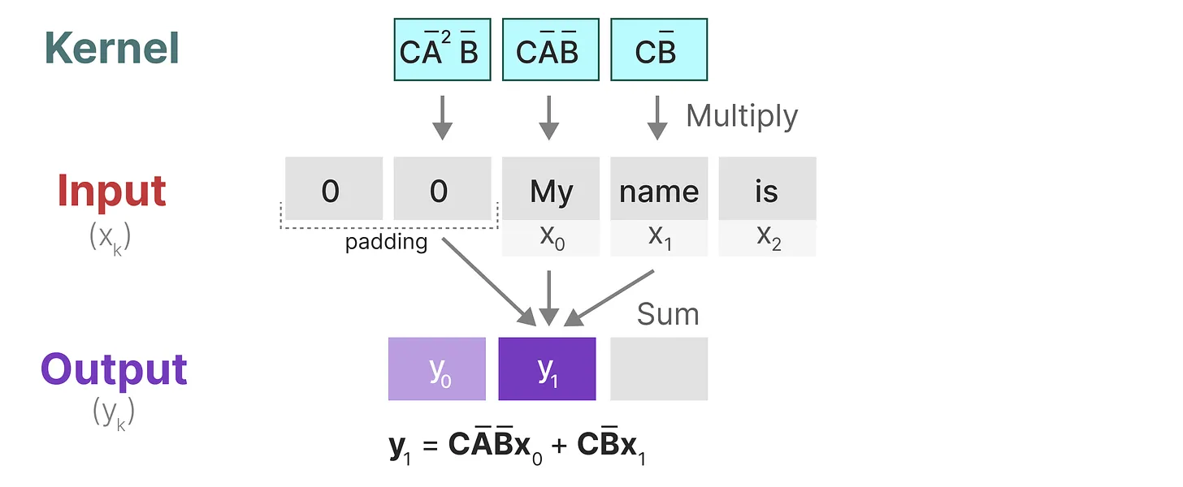
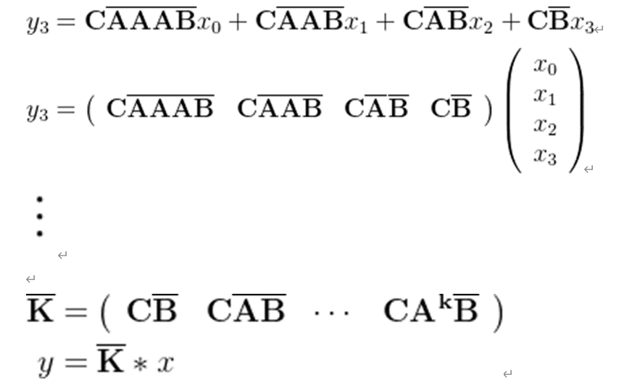


Slide 28

Summary
Since we have the recurrent way and convolutional way, we can choose a way that fits our mission when doing.

Slide 29

But here is another question, we just focus on the current three tokens, how can I have a longer memory?

Slide 30


The solution to the Long-Range Dependency problem——HiPPO
Arguably one of the most important aspects of the SSM formulation is matrix A. As we saw before with the recurrent representation, it captures information about the previous state to build the new state.
Matrix A produces the hidden state:

Slide 31



HiPPO Framework (High-Order Polynomial Projection Operator)
HiPPO attempts to compress all input signals it has seen thus far into a vector of coefficients. Early signal information may experience greater degradation over time, while the latest steps will only experience smaller degradation.
coefficients evolve through time (red, blue) according to a linear dynamical system.
HiPPO Matrix does this by keeping track of the coefficients of a Legendre polynomial.
HiPPO: Recurrent Memory with Optimal Polynomial Projections
https://arxiv.org/abs/2008.07669

Slide 32


Why track the coefficients of a Legendre polynomial?
Legendre polynomials are a set of orthogonal polynomials defined on the interval [−1,1].
HiPPO mainly uses orthogonal polynomials to compress and represent time series data.
The Legendre polynomials P_n(x) are defined as follows:
P_0(x) = 1
P_1(x) = x
P_2(x) = 1/2(3x^2 - 1)
...

Slide 33


Orthogonal Function
In Vector, If A·B = 0, then A and B are Orthogonal.
In n-dimensional space, if there is a vector P that is orthogonal to (n-1) of n pairwise orthogonal vectors, P must be linearly related to the remaining one vector.
Function can be seen as the combination of infinite small vectors.
If the real function f(x) is defined on the interval [a, b], and Δx is sufficiently small, we can get vector F.

Slide 34


f(x) can be represented by a linear combination of the M numbers of M-dimensional vectors that are orthogonal to each other.
Because they are orthogonal to each other, we can pick two from them, let m!=n

Slide 35


Multiply both sides of the equation by Δx
Integral all of them
Next, we will talk about why it is easy to get the coefficient.

Slide 36


f(x) should be equal to the linear combination of M (infinity) number of M-dimensional orthogonal function sets.
Multiply both sides of the equation by g_n(x)

Slide 37

The red line represents the curve we are approximating, while the black bars represent the values of our hidden state. Each is a coefficient for one element of the Legendre series shown as blue functions. The intuition is that the HiPPO matrix updates these coefficients at each step.

Slide 38



Summary
1. Constructing Projections
2. Coefficient Calculation

Slide 39



Back to HiPPO Matrix
Rodrigues' formula provides an explicit construction method for Legendre polynomials. For the n-th order Legendre polynomial P_ n(x), Rodrigues' formula is given by:

Slide 40

Summary

Slide 41


Efficiently Modeling Long Sequences with Structured State Spaces
https://arxiv.org/abs/2111.00396

Slide 42
Selective SSM
（Mamba motivation）

Slide 43

Why do we need a selective SSM?
Without selectivity, S4 would spend the same "effort" processing each word

Slide 44

But if it were a model trying to classify the intent of this sentence, it might want to "focus" more on "order, hamburger" rather than "want, to"

Slide 46


Slide 47
Reference
Gu, A., & Dao, T. (2023, December 1). Mamba: Linear-time sequence modeling with selective state spaces. arXiv.org. https://arxiv.org/abs/2312.00752
Grootendorst, M. (2024, February 19). A visual guide to Mamba and state space models. A Visual Guide to Mamba and State Space Models. https://newsletter.maartengrootendorst.com/p/a-visual-guide-to-mamba-and-state
State space models and filtering - penn arts & sciences. (n.d.). https://www.sas.upenn.edu/~jesusfv/LectureNotes_9_filtering.pdf

